Slide 1
CSE 803: Project
Image-to-Image Translation (Sketch to Image)
Asadullah Hill Galib

Slide 2
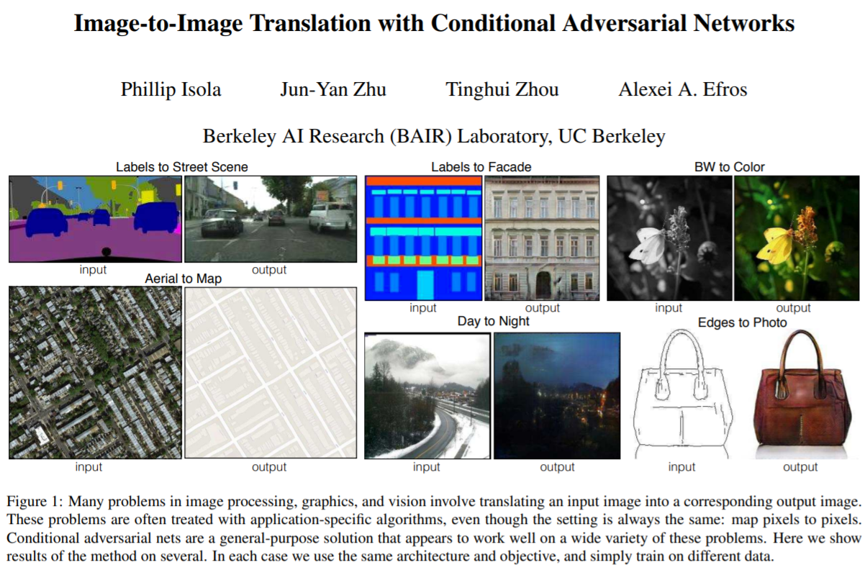
Motivation
Source: Isola, P., Zhu, J. Y., Zhou, T., & Efros, A. A. (2017). Image-to-image translation with conditional adversarial networks. In Proceedings of the IEEE conference on computer vision and pattern recognition (pp. 1125-1134).

Slide 3
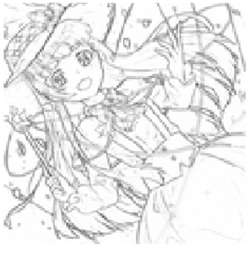
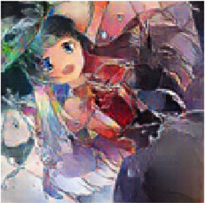
Problem Definition
Sketch to Image Generation
Given sketch-image pairs, train model to generate colored images
Using U-net Generator and conditional GAN
Colored Image
Sketch
Generated Image
Ground Truth

Slide 4
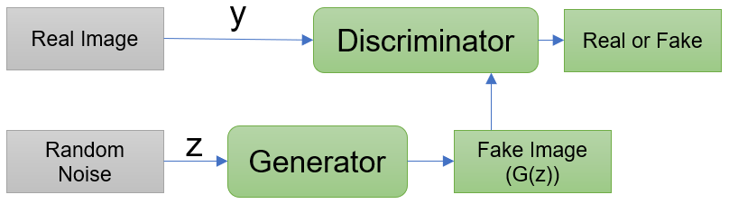
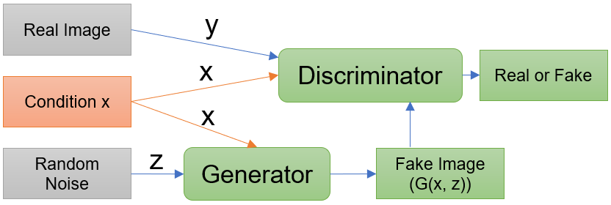
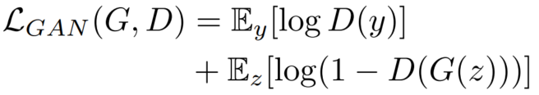
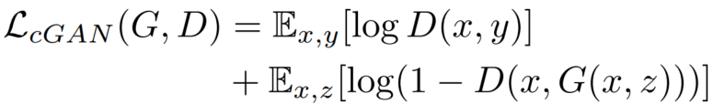
Architecture (GAN vs cGAN)
GAN
cGAN

Slide 5
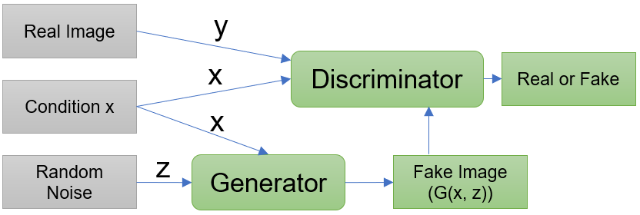
Architecture (cGAN)
cGAN

Slide 6

Architecture (U-net-based Generator)
Source: Ronneberger, O., Fischer, P., & Brox, T. (2015, October). U-net: Convolutional networks for biomedical image segmentation. In International Conference on
Medical image computing and computer-assisted intervention (pp. 234-241). Springer, Cham.

Slide 7
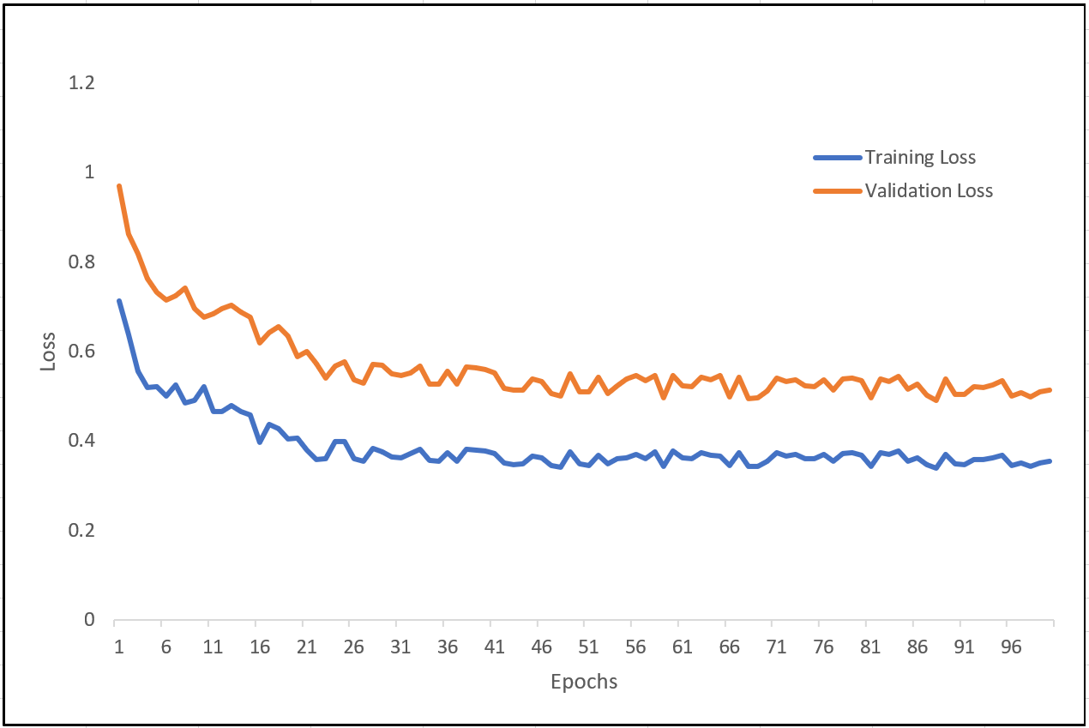
Results (U-net-based Generator)
Learning Curve:

Slide 8
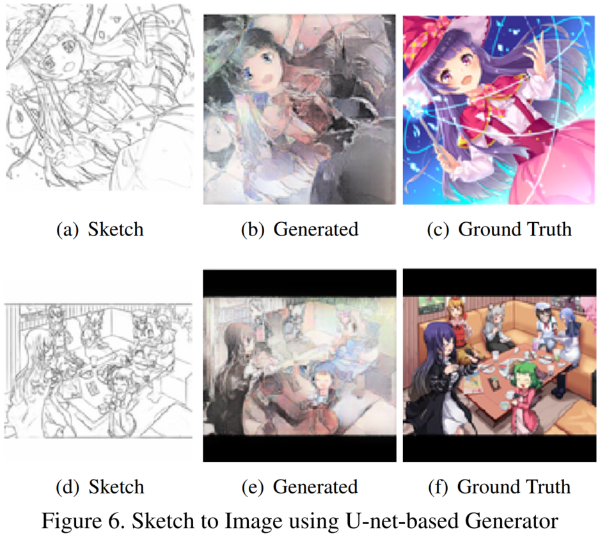
Results (U-net-based Generator)
Sketch to Image using U-net-based Generator:

Slide 9
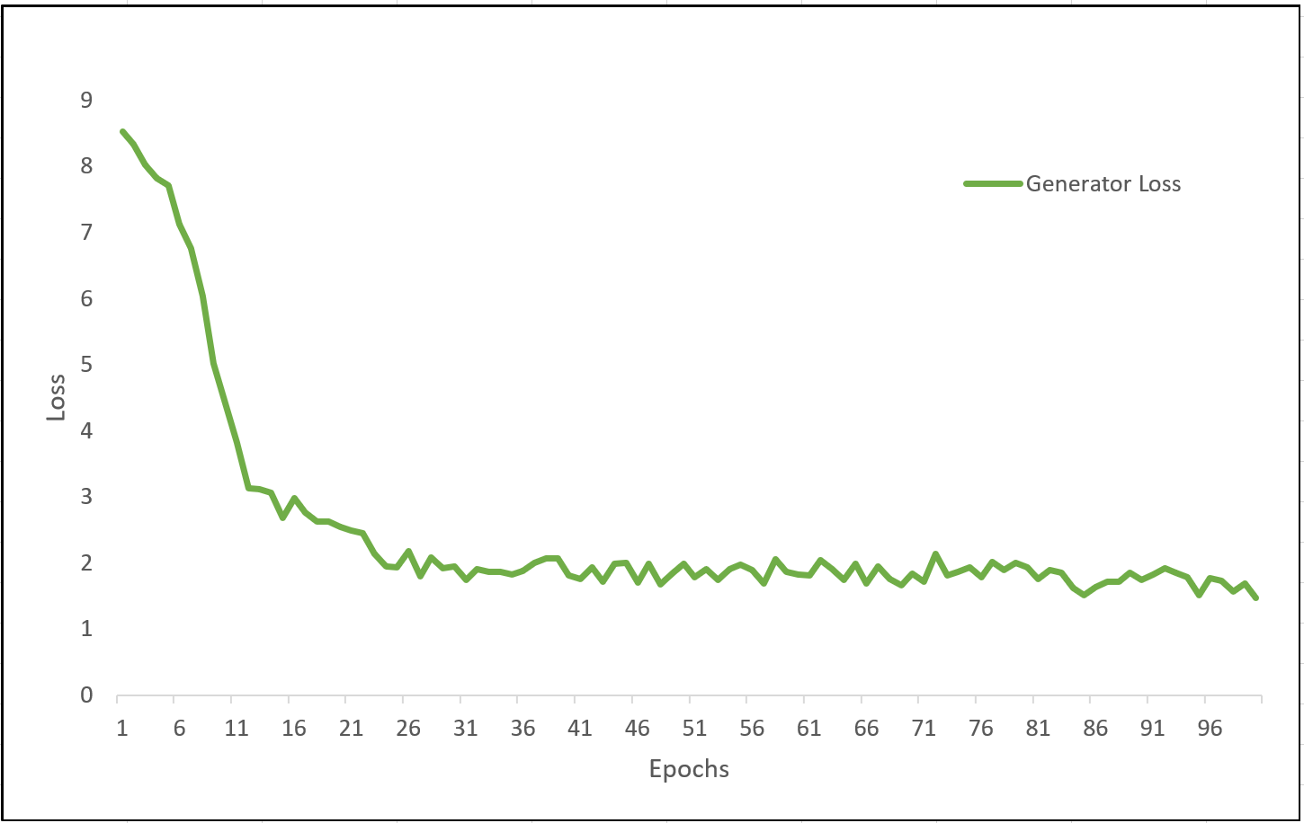
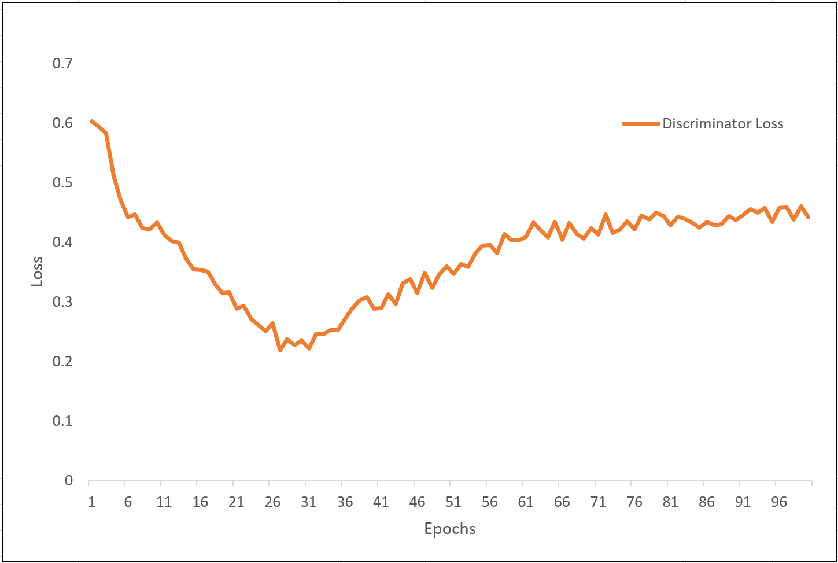
Results (cGAN)
Learning Curve of Generator and Discriminator:

Slide 10
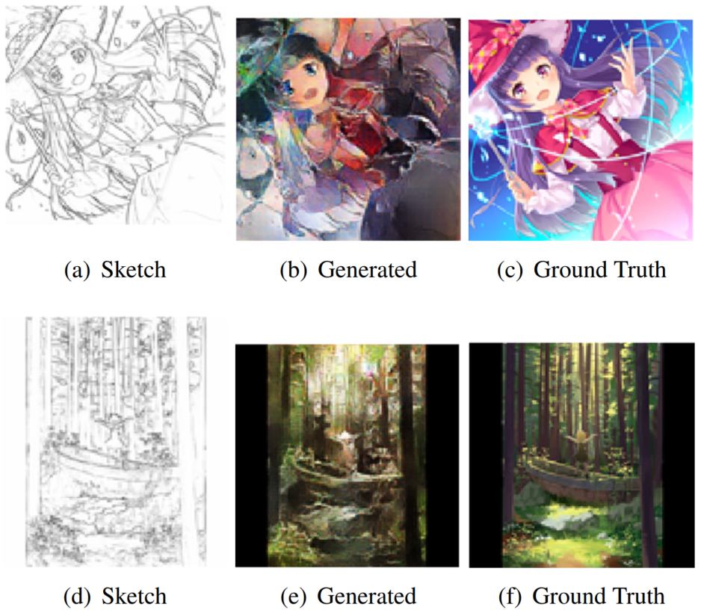
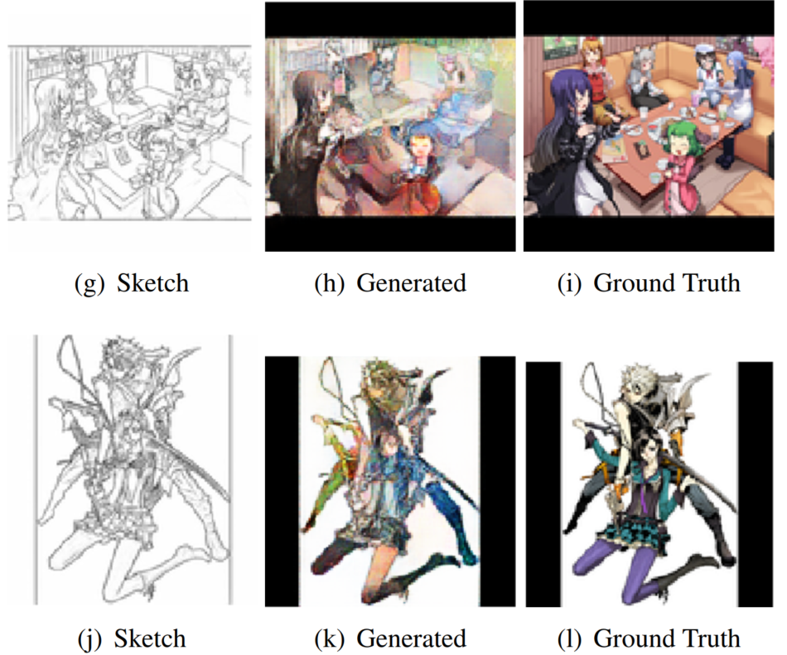
Results (cGAN)
Sketch to Image using cGAN architecture:

Slide 11
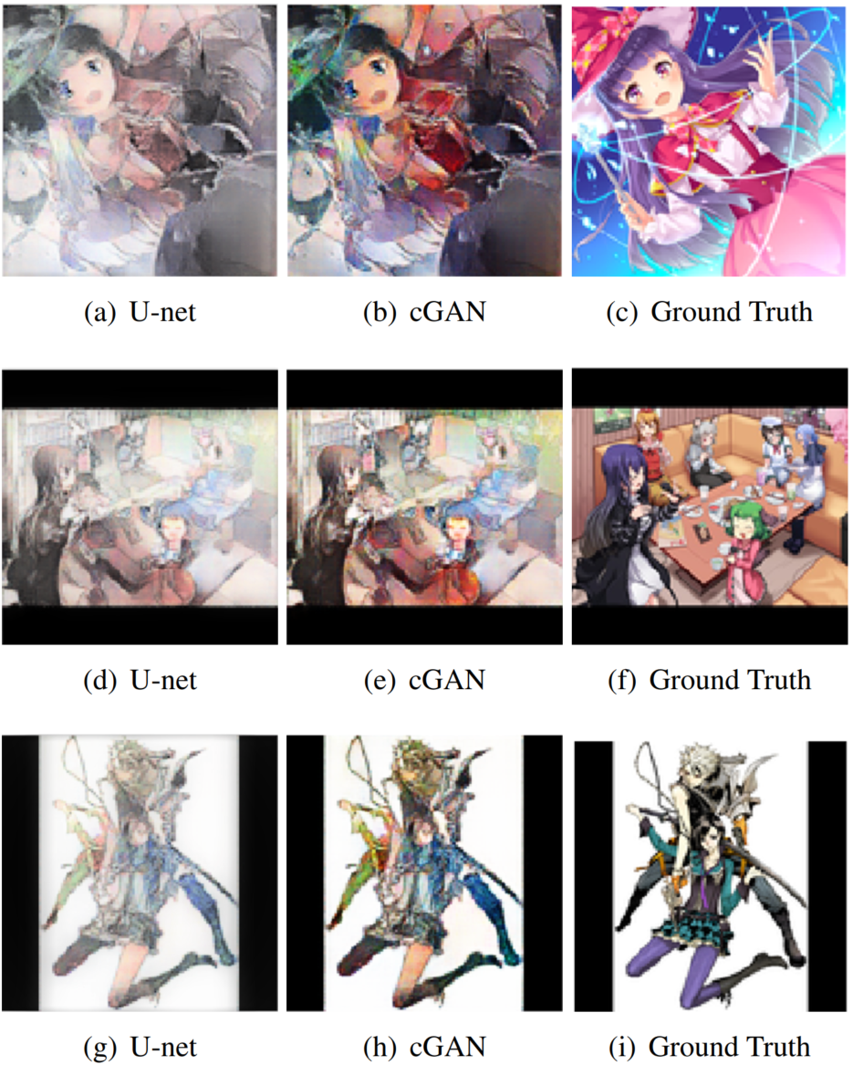
Results (U-net-based Generator vs cGAN)
Comparison between U-net Generator (without discriminator) and cGAN architecture (with discriminator):

Slide 12
Thank you

Slide 13
y
Real Image
Discriminator
Real or Fake
Random Noise
z
Generator
Fake Image (G(z))
Real Image
y
x
Discriminator
Real or Fake
Condition x
x
Random Noise
z
Generator
Fake Image (G(x, z))

